Slide 1
data collection and decision making

Slide 2
admin

Slide 3
Tīw’s Day

Slide 4
shapefile
spatial datasets
predate geodatabse,
still widely used,
Only vector data, no curves
different pieces
2 GB Limit
Notes:
* Shapefiles
* filename.shp - containing the coordinates
* filename.dbf - containing the attributes
* filename.shx - containing linkages, other info
* filename.prj - optional, containing projection information
* filename.sbn - an optional indexing file

Slide 5
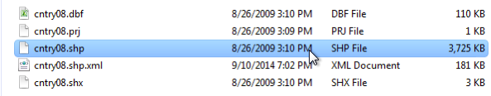
Notes:
* Shapefiles
* filename.shp - containing the coordinates
* filename.dbf - containing the attributes
* filename.shx - containing linkages, other info
* filename.prj - optional, containing projection information
* filename.sbn - an optional indexing file

Slide 6
geodatabases
tables, shapefiles, rasters, annotation
true curves
2 terabyte limit per feature class
Enterprise geodatabases have no limits
Must be created in ArcGIS

Slide 7
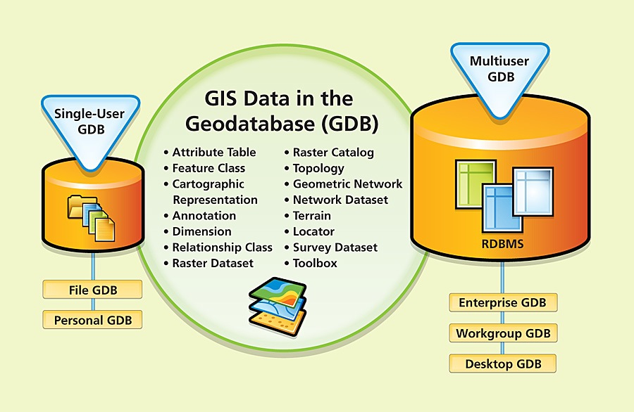
What is a Geodatabase?

Slide 8
9-1-1 Context
Notes:
Before Start:
- Handout – syllabus
Turn up volume for scream effect
Open blank arcmap

Slide 9
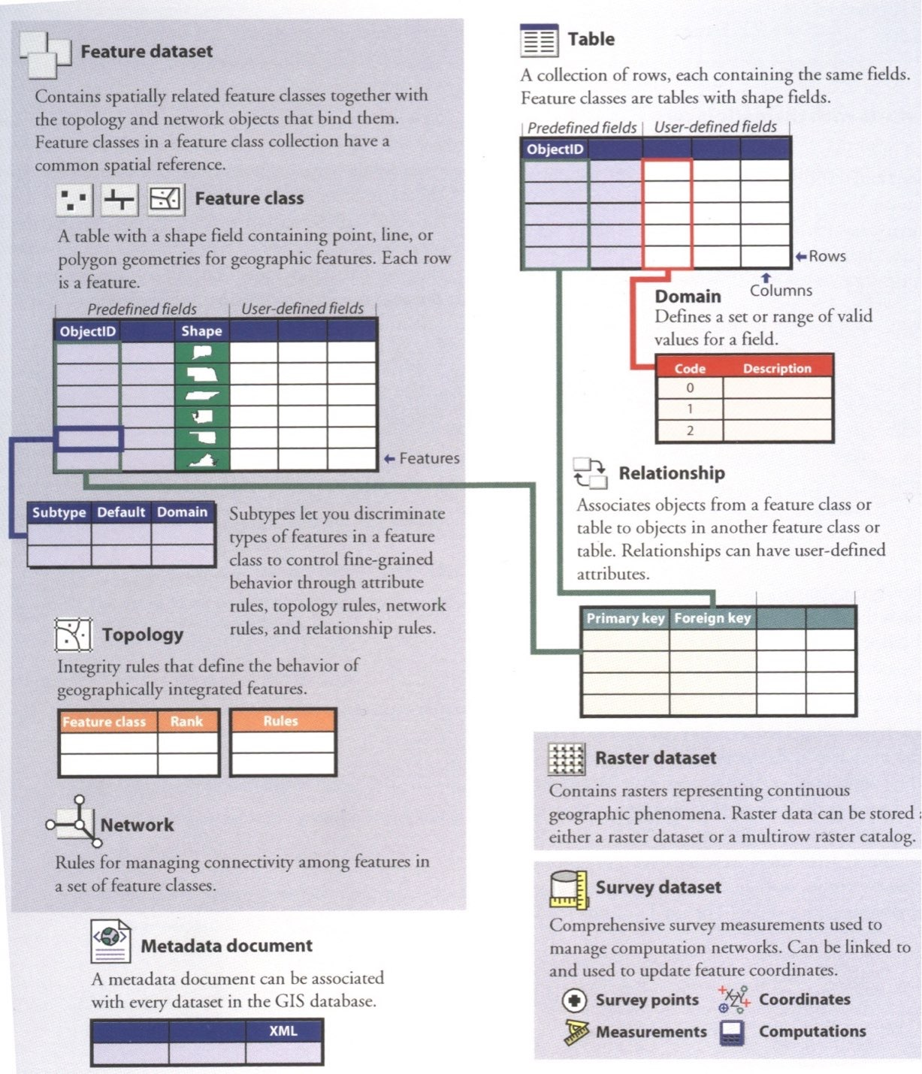
From Arctur(2004)

Slide 10
From Arctur(2004)

Slide 11
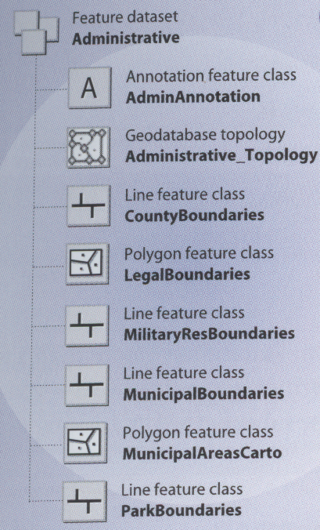
feature dataset
contains spatially related features
logical organization container
Notes:
Calgary – Address FDS, Administrative, Census 200 etc

Slide 12
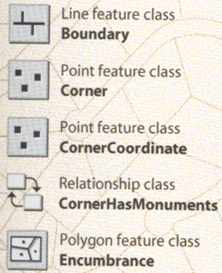
feature class
primary storage for spatial data
standalone and part of feature dataset
Notes:
Many feature classes in Calgary

Slide 13
what is a feature?
Notes:
Before Start:
- Handout – syllabus
Turn up volume for scream effect
Open blank arcmap

Slide 14
where the data?
Notes:
Before Start:
- Handout – syllabus
Turn up volume for scream effect
Open blank arcmap

Slide 15
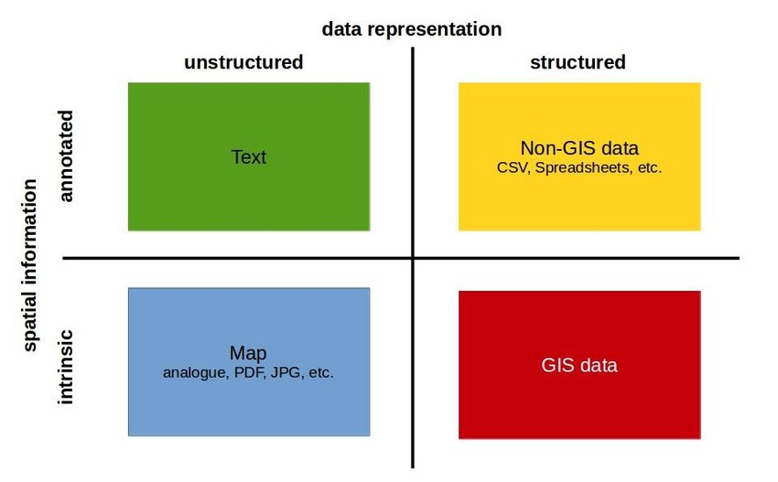

Slide 16
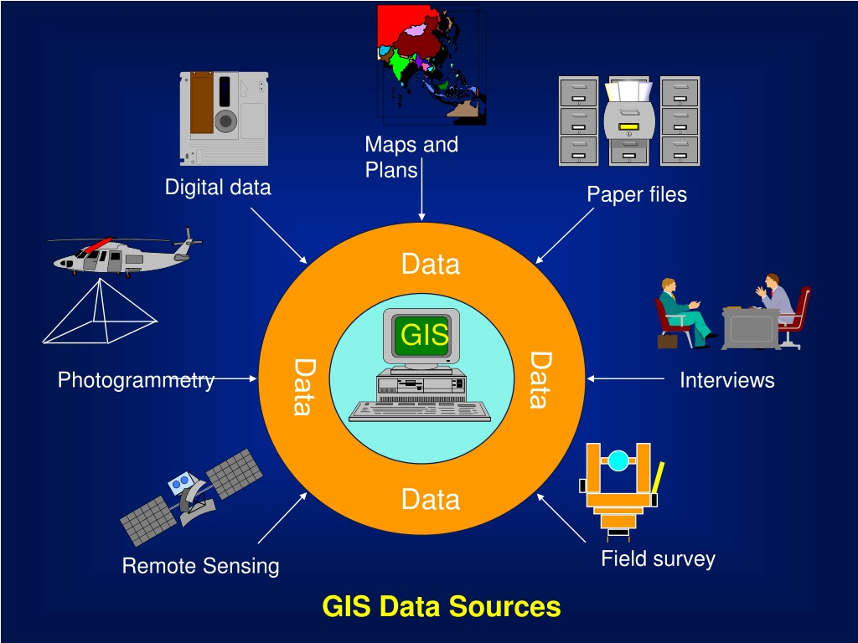

Slide 17
metadata
Notes:
Metadata
metadata are the most forgotten data type
absolutely necessary if you’re going to use data, or if someone is going to use your data later (or your derivative information)
contains information about
scale
accuracy
projection/datum
data source
manipulations
how to acquire data
many different “standards” for collection and presentation of metadata, such as FGDC used by US gov’t agencies.
Just look at the metadata pane for what all is in there.

Slide 18
primary vs secondary
Notes:
Before Start:
- Handout – syllabus
Turn up volume for scream effect
Open blank arcmap

Slide 19
field text digitizing scanning
Notes:
Before Start:
- Handout – syllabus
Turn up volume for scream effect
Open blank arcmap

Slide 20
local state federal (inter)national
Notes:
Before Start:
- Handout – syllabus
Turn up volume for scream effect
Open blank arcmap

Slide 21
types of maps

Slide 22
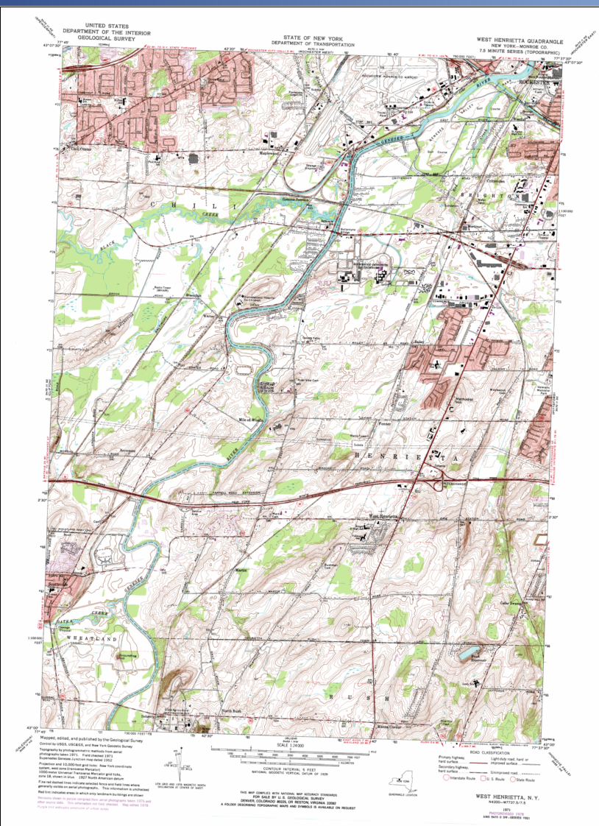
Reference Map
No specific info
base map oriented

Slide 23
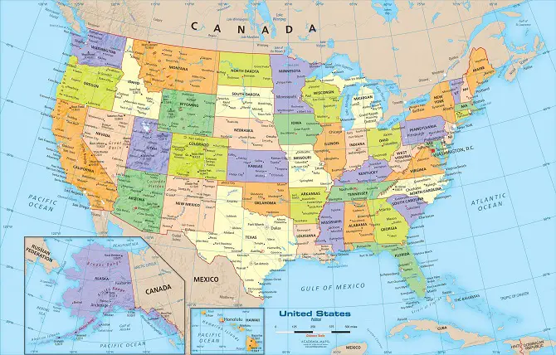

Slide 24
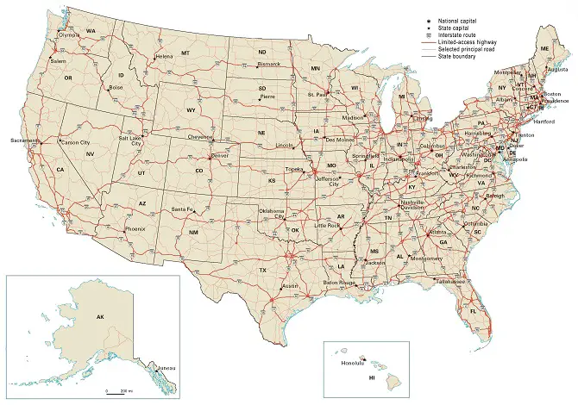

Slide 25
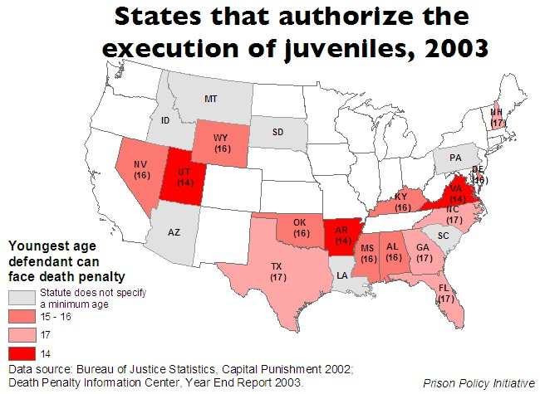
thematic map
Distributions of a single attribute
Relationships among several attributes
http://www.prisonpolicy.org/images/juvenile_dp_laws_us.jpg

Slide 26
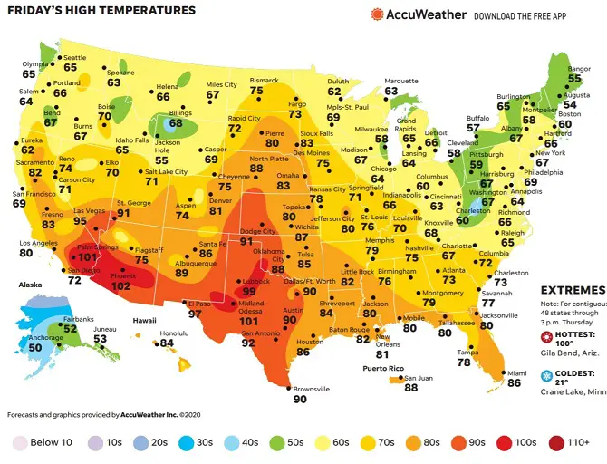

Slide 27
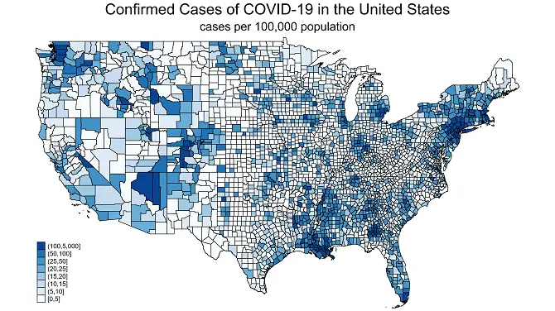

Slide 28
bye!
Notes:
Before Start:
- Handout – syllabus
Turn up volume for scream effect
Open blank arcmap

Slide 29
Thunor’s dæg
Notes:
Before Start:
- Handout – syllabus
Turn up volume for scream effect
Open blank arcmap

Slide 30
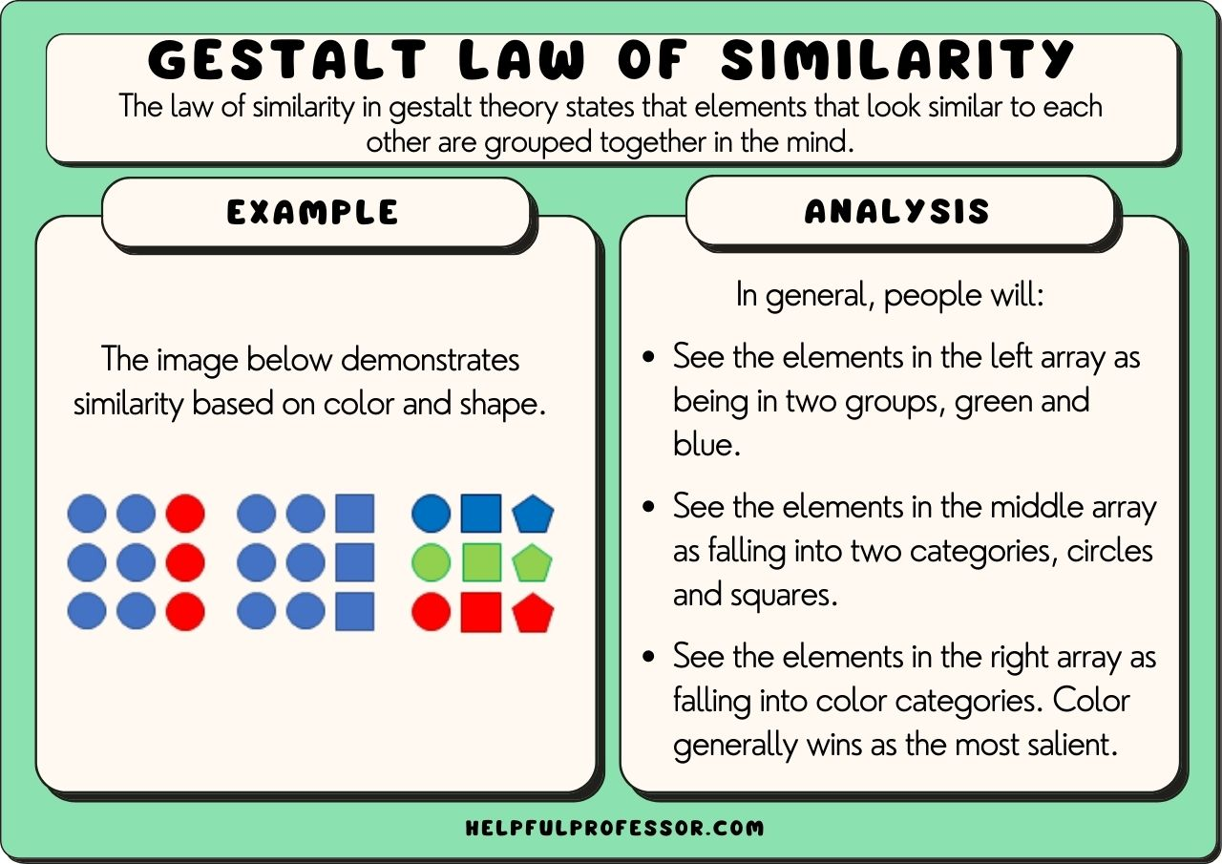

Slide 31
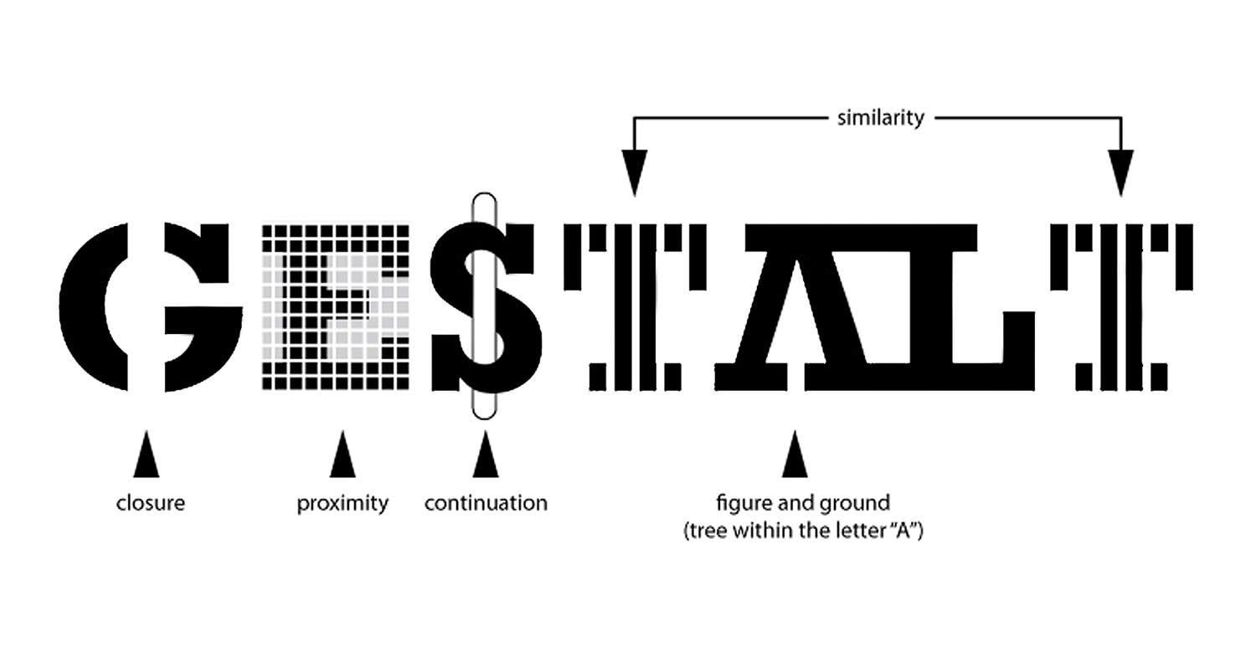

Slide 32
Basics of Map Design
Graphic Elements
Figure/Ground
Visual Variables

Slide 33
Graphic Elements
First St.
Point
Line
Area
Park
Home St.
River
My house

Slide 34

Figure/Ground
Main figure on the map vs. background
Ambiguous FG – vase or faces?

Slide 35
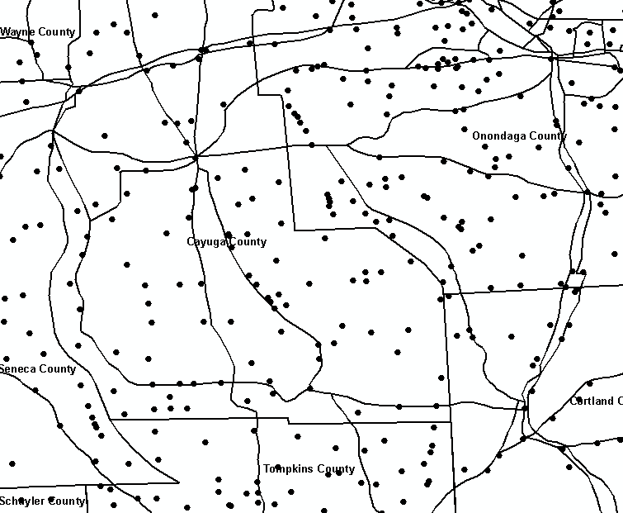
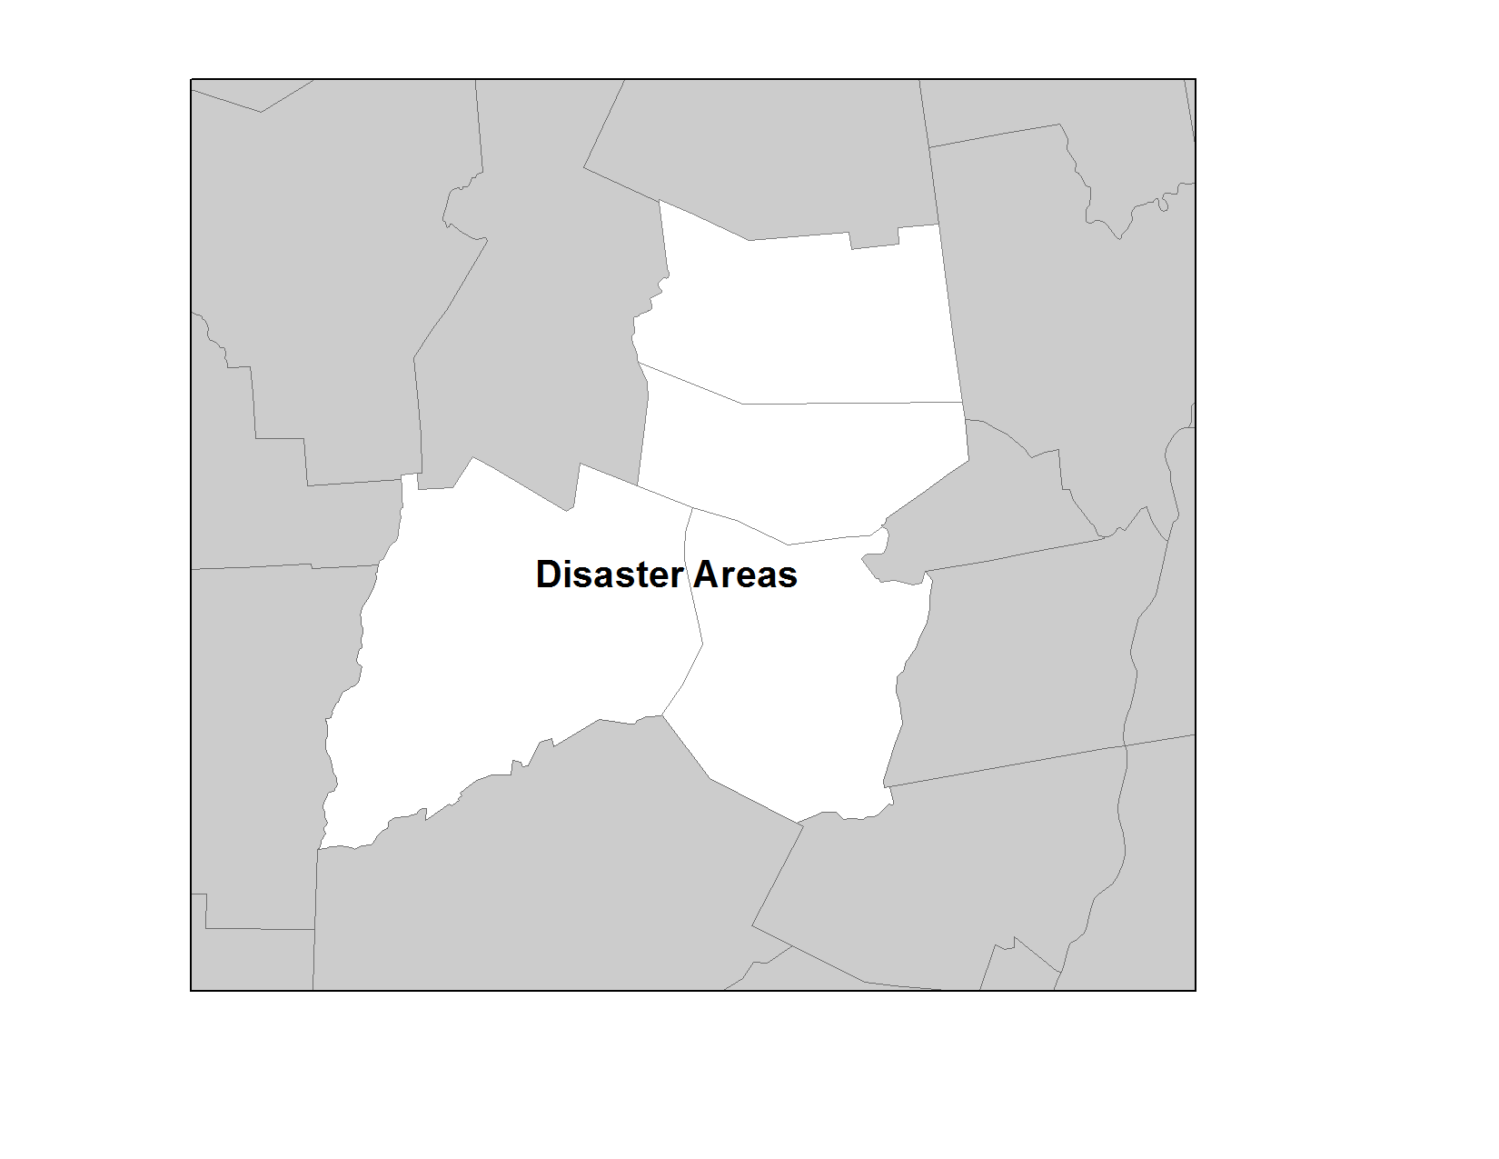
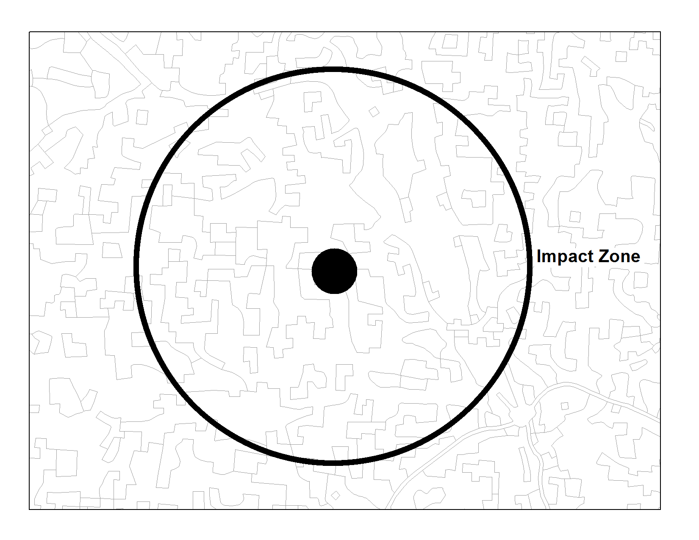
Figure/Ground
Dark – Ground
Light - Figure
Ambiguous FG
Dark – Figures
Light - Ground
© 2013 B. Tomaszewski

Slide 36
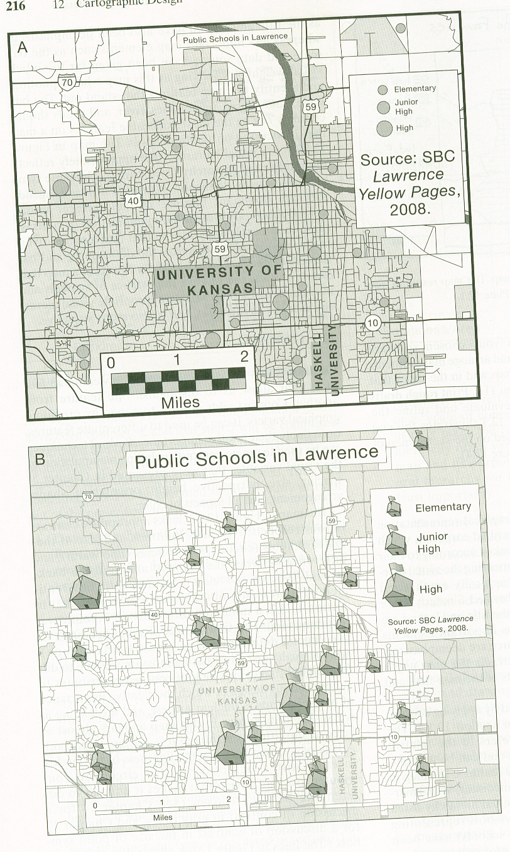
Visual Hierarchy
Slocum et. al. 2005
Notes:
Graphical repreentation of intellectual hierarchy

Slide 37
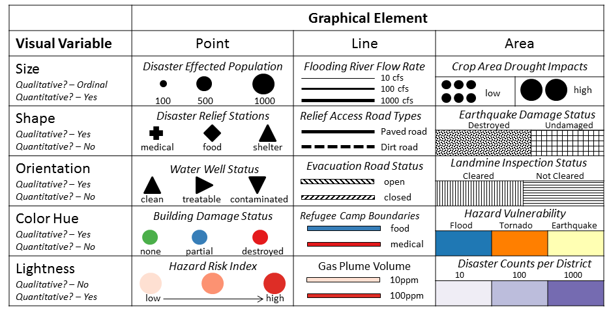
Visual Variables
© 2013 B. Tomaszewski

Slide 38
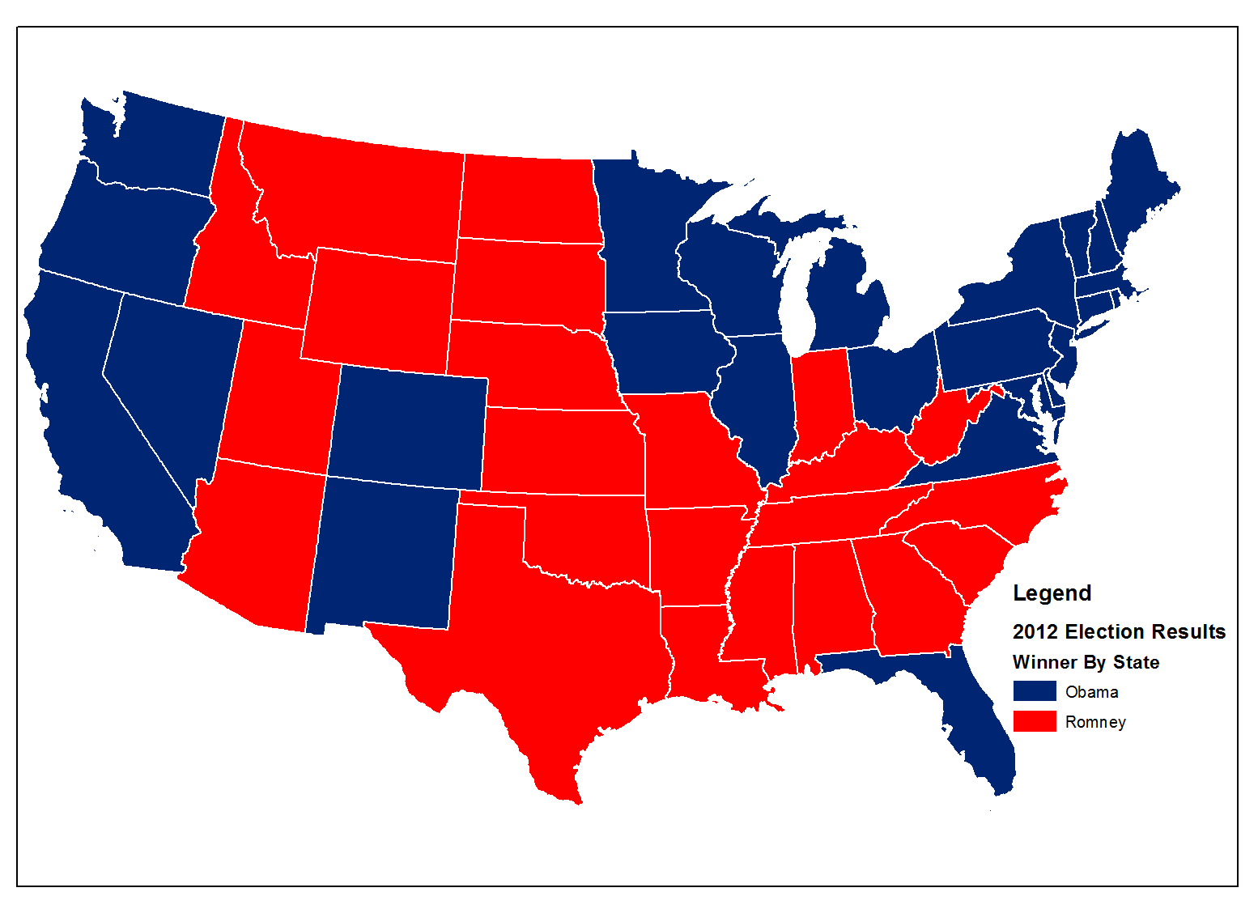
Color Hue - Qualitative Distinction
© 2013 B. Tomaszewski

Slide 39
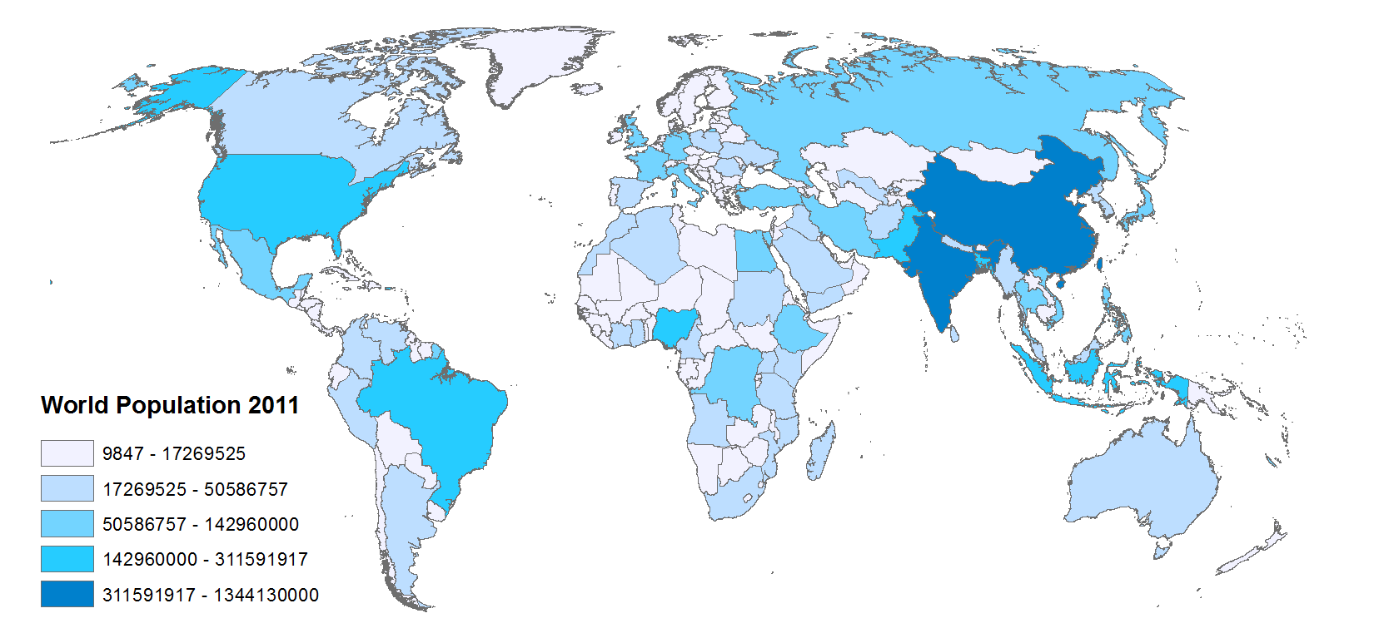
Lightness - Quantitative Distinction
© 2013 B. Tomaszewski

Slide 40
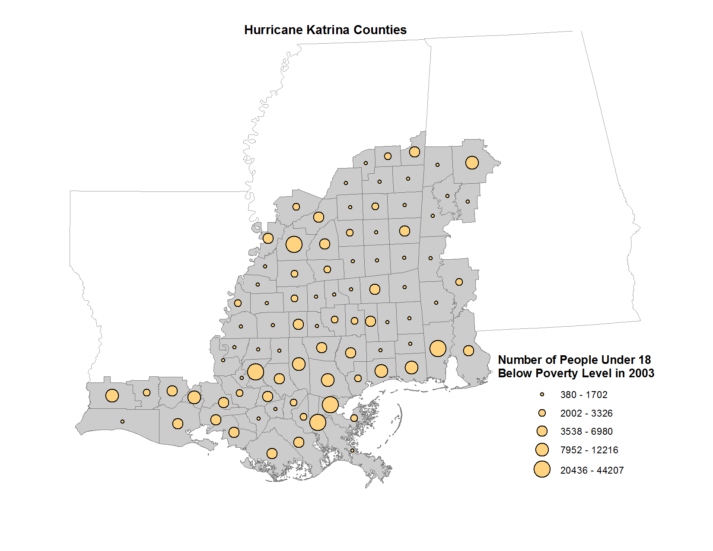
Size - Quantitative Distinction
© 2013 B. Tomaszewski

Slide 41
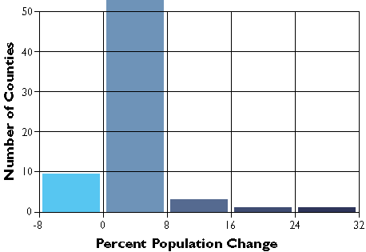
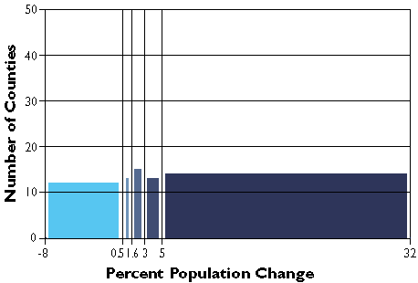
Thematic Mapping
Equal Interval
Equal range of values in each class
Each class will likely contain a different number of features
Divide the total range of values by the number of classes (in our case, 5)
this gives you the value range of each class
Quantile (percentile)
Equal number of features in each class

Slide 42
Natural Breaks (Jenks)

Slide 43
Natural Breaks (Jenks)

Slide 44
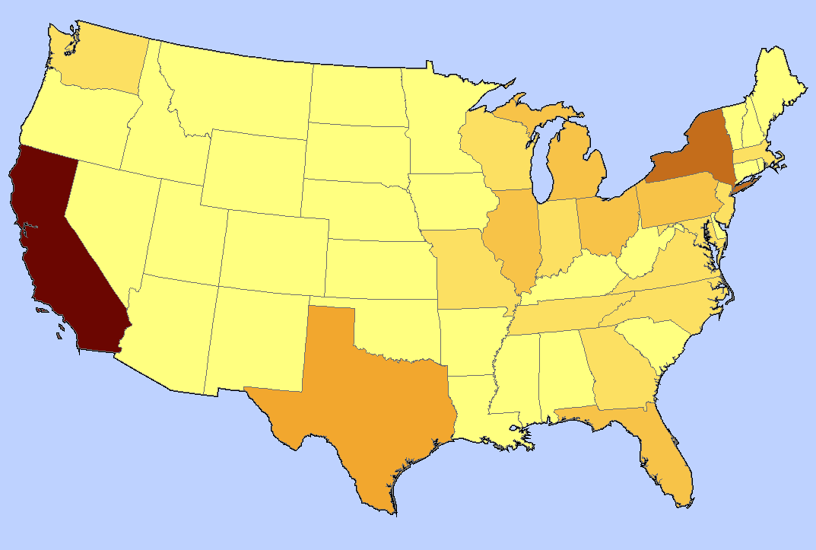
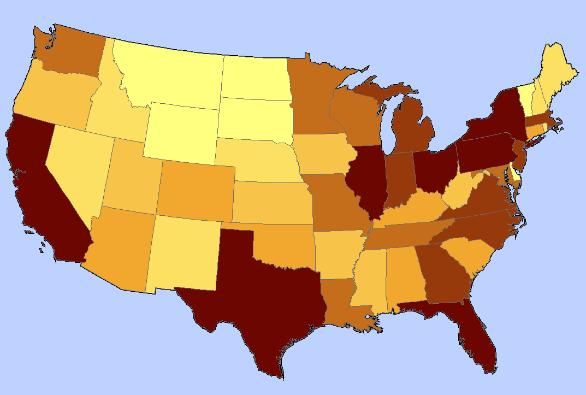
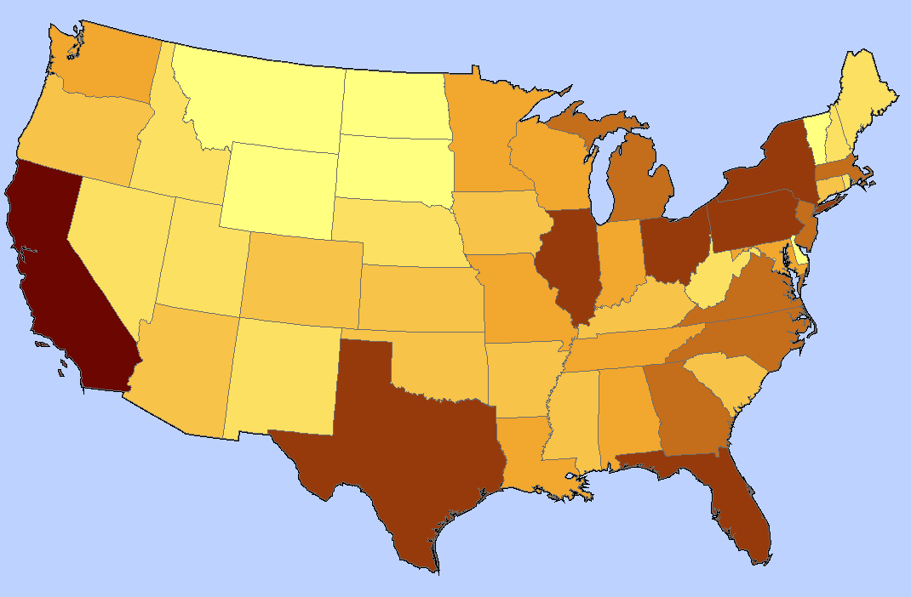
Comparison of equal interval, quantile and Jenks
Equal interval
Quantile
Jenks
Notes:
When is it useful to choose the method of equal class intervals?
It is appropriate to use equal class intervals when the data distribution has a rectangular shape in the histogram. This, however, occurs very rarely in the context of geographic phenomena. Moreover, it is useful to use this method when your classification steps are nearly equal in size. The major disadvantage of this method is that class limits fail to reveal the distribution of the data along the number line. There may be classes that remain blank, which of course is not particularly meaningful on a map.
Quantiles Classification
An advantage of quantiles is that classes are easy to compute, and that each class is approximately equally represented on the final map. Moreover, quantiles are very useful for ordinal data, since the class assignment of quantiles is based on ranked data. The main disadvantage of this classification method are the gaps that may occur between the observations. These gaps sometimes lead to an over-weighting of some single detached observations at the edge of the number line.
The Natural Breaks Classification
Applying the classification method of "natural breaks”, we consider visually logical and subjective aspects to grouping our data set. One important purpose of natural breaks is to minimise value differences between data within the same class. Another purpose is to emphasize the differences between the created classes.
A disadvantage of this method is that class limits may vary from one map-maker to another due to the author's subjective class definition (Slocum 1999). The Jenks-Caspall Alorithm formalizes this procedure and is often used in GIS software.
http://www.gitta.info/Statistics/en/html/StandClass_learningObject2.html

Slide 45
Picking Colors
Lots of things to take into consideration with your map color schemes
Main one is the audience and what you are trying to tell
ArcGIS Symbology Templates are a good place to start
For more advanced ideas there is the colorbrewer2.org web site
Gives you colors and ramps to fit a variety of different use cases
Can pick colorblind safe, print friendly, or photocopy safe schemes

Slide 46
Working With Layouts
What maps do?
maps convey geographic information
highlight geographic relationships
present analysis results
guide people to a location

Slide 47
Working With Layouts
Things to consider when making a map
how and where it will be presented
who is the intended audience
reality and the need to generalize
scale and technical limits

Slide 48
Gretchen Peterson’s Map Evaluation Checklist

Slide 49
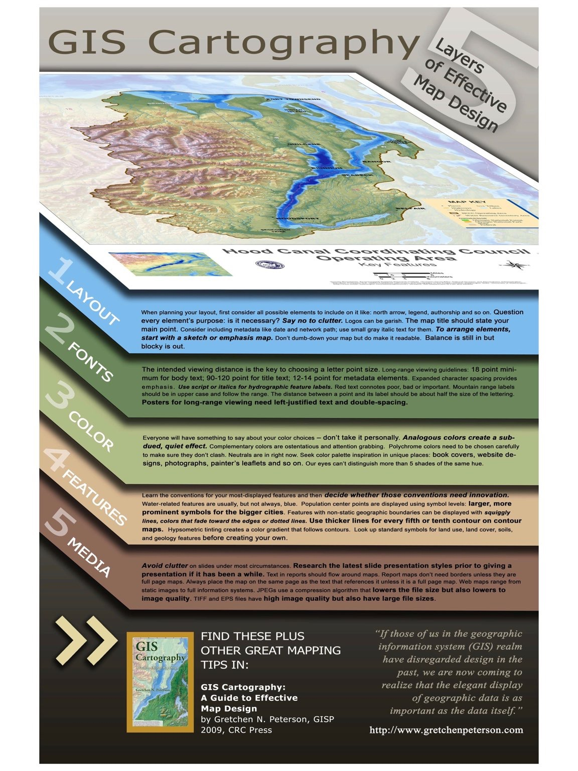

Slide 50

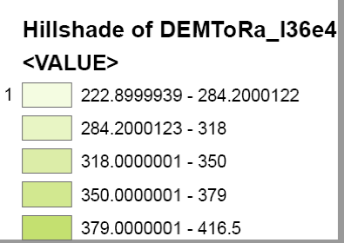
Things to Watch For
remove_underscores_from_titles_they_look_funny
round numbers so there aren't as many decimal places

Slide 51
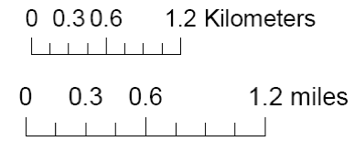
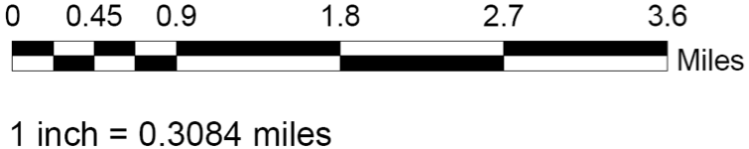
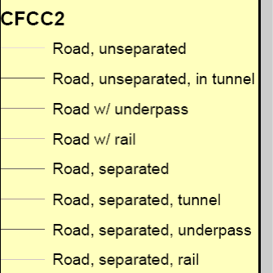
Things to Watch For
use even rounded numbers for scale bar increments. for example, end the graphic scale at 5 miles or 2.5 miles
use different sizes as well as colors to discern the various feature types (roads in this example), especially when you showing many classes, in this example, they are hard to understand. Also, make sure labels are intuitive – in this example, what does "road, unseparated" really mean? better classification would be "interstates, county roads etc
make sure your legend titles are meaningful and will be understood by someone other than you

Slide 52
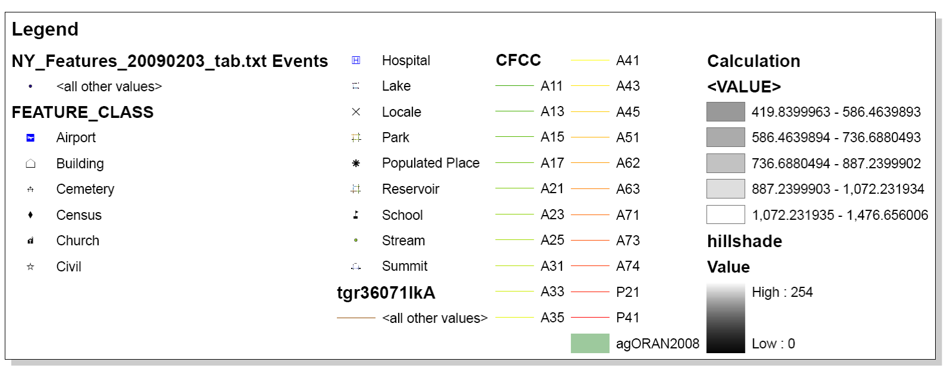
Things to Watch For
????
make sure all legend items are relevant
????
Is this needed?

Slide 53
querying and selecting
query
>>> ask a question

Slide 54
querying and selecting - arcmap
identify
using a graphic
select loc/att
select by attribute
find

Slide 55
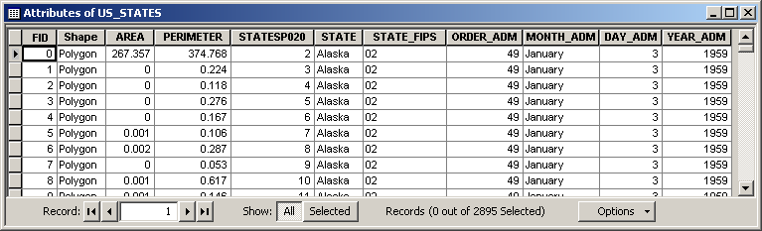
Query Basics
SELECT * FROM US_STATES WHERE STATE = ‘Alaska’
“where the value of the STATE column is equal to the value ‘Alaska’”
“give me everything from the table US_STATES”

Slide 56
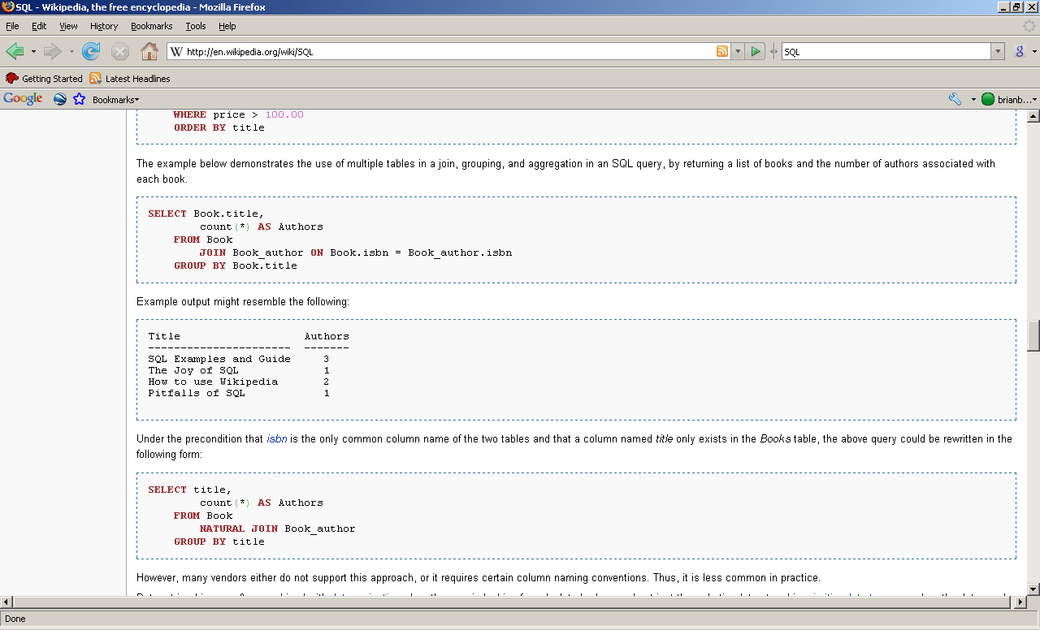

SQL
Structured Query Language
Used Implicitly and Explicitly in ArcGIS
Combine tables, fields, operators, much more..

Slide 57
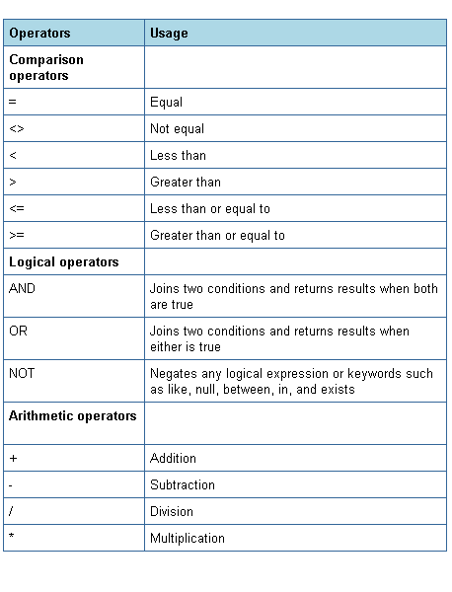
SQL WHERE Operators
http://iuiedocs.oes.indiana.edu/images/operators.png

Slide 58
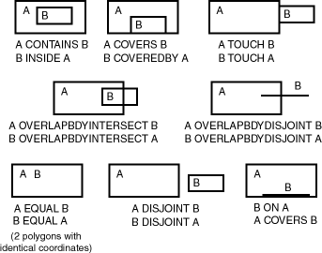
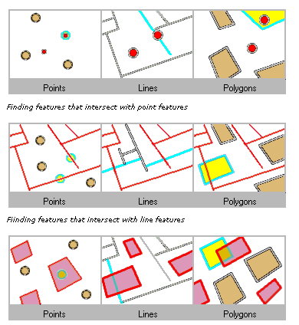
Spatial Operators for Querying
http://www.stanford.edu/dept/itss/docs/oracle/10g/appdev.101/b10826/top_rel.gif
Intersect Example
Non-exhaustive list
See ArcGIS Help Topic “Select By Location dialog” for more info
Used as a “spatial” WHERE clause

Slide 59
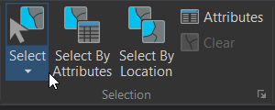
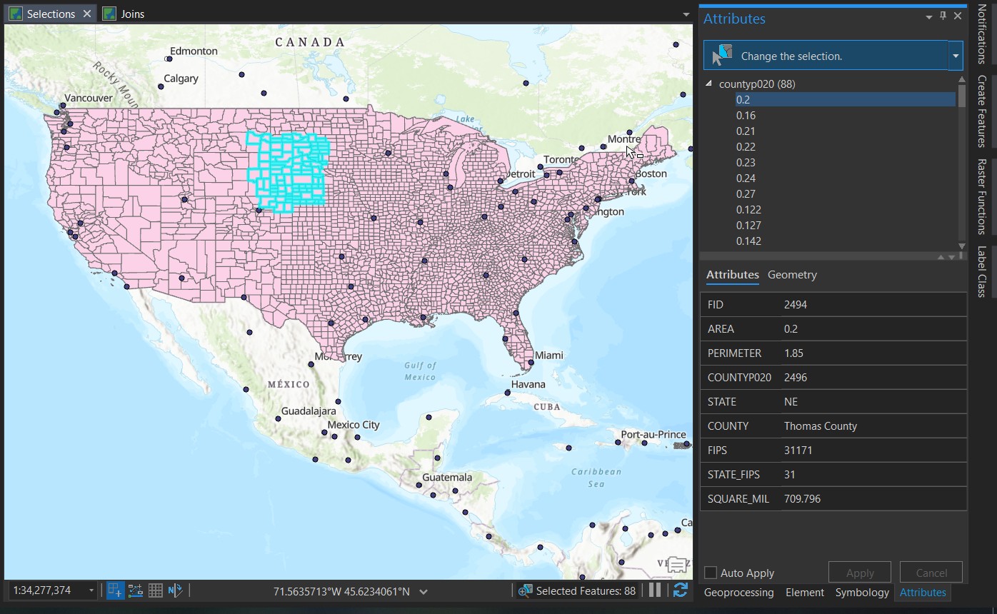
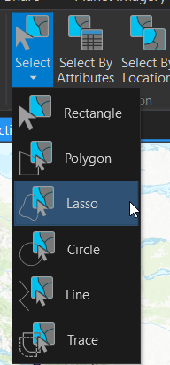
Interactive Selection Tool

Slide 60
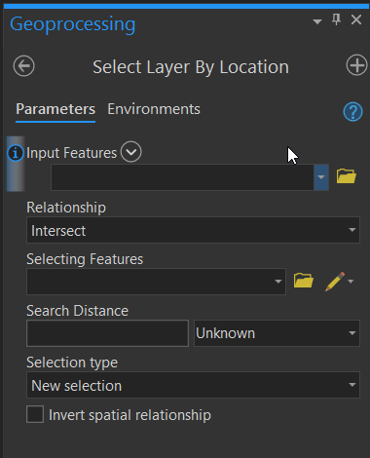
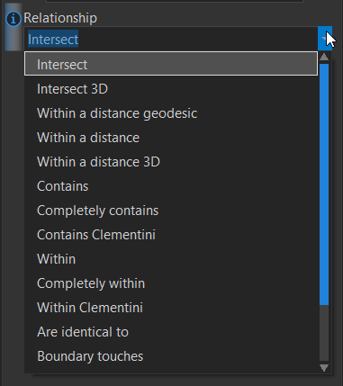
Select by Location
Uses Spatial Operators

Slide 61
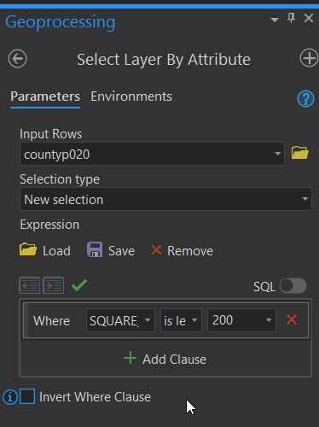
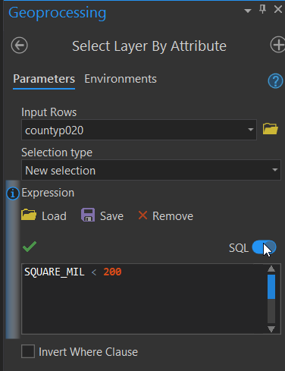
Select by Attribute
Build the WHERE part of query
Full query being built

Slide 62
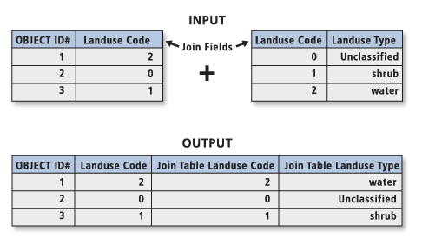
Table Join
“Appending the fields of one table to those of another through an attribute or field common to both tables. A join is usually used to attach more attributes to the attribute table of a geographic layer.”
Notes:
When you join two tables, you append the attributes from one onto the other based on a field common to both.

Slide 63
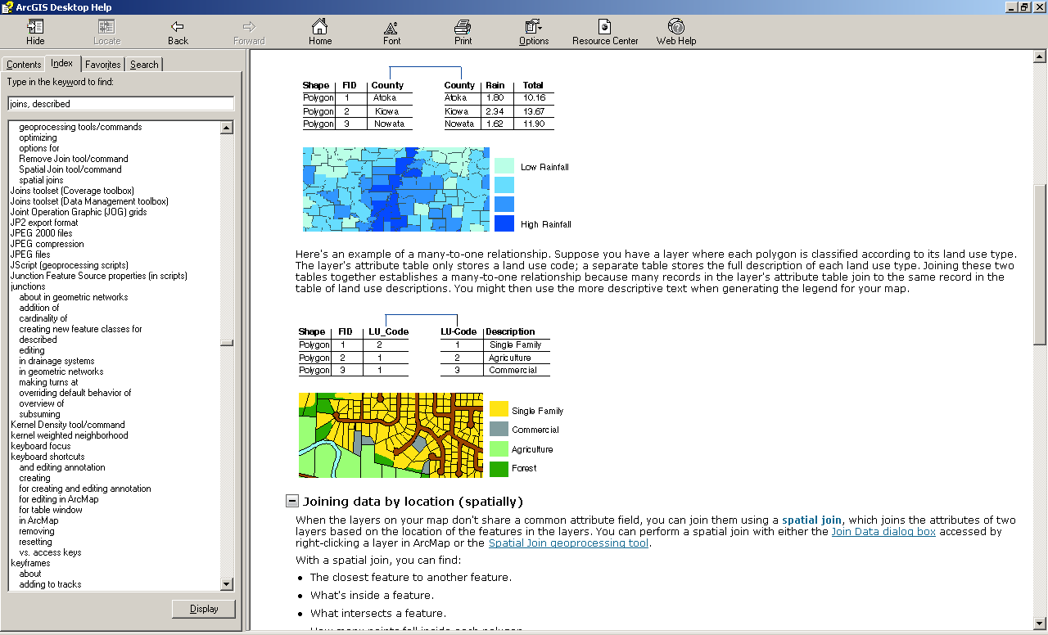
Join on number
Join on string (text)

Slide 64
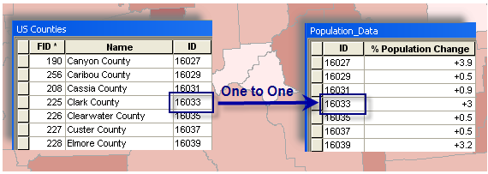
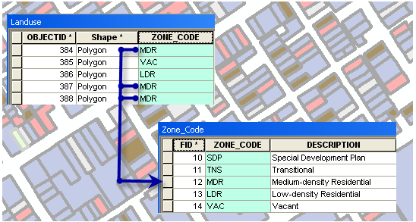
One to Many
Notes:
Caution:
If you try to create a join on a 1:M relationship, only the first match will be joined in the resulting joined layer.

Slide 65



Slide 66
Hands-on – Querying and Table Joins
Please do not do these steps until told to do so by the instructor (i.e. no skipping ahead)
Download and unzip locally the file Week4_hands_on_materials.zip from myCourses under Content Week 4
Look at a File Geodatabase
Select by location (counties/cities) (All cities within NY counties)
Table join (observe different data types)

Slide 67
Lab - GIS and Basic Map Making Due Date: September 30th 11:59 PM
Reminders:
Data is Lab4Data.zip
Next Class Readings

Slide 68
Readings
Brewer_Designing_Better_Maps_Ch_1
GIS cartography poster by Gretchen Peterson
Map Evaluation Checklist
MacEachren_1995_c1
GPS-Posterweb
Difference between recreational and professional grade gps receivers
why-postprocess

